Slide 1
SDN BY L S JISHNU BHUVANESH II MCA “A”

Slide 2
Definition of SDN
SDN stands for Software Defined Network which is networking architecture approach. It enables the control and management of network using software applications
Software Defined Network improves performance by network virtualization
SDN can create virtual network or it can control traditional network with the help of software.

Slide 3
TRADITIONAL NETWORK
Traditional network refers to the old conventional way of networking which uses fixed and dedicated hardware devices such as routers and switches to control network traffic.
Traditional network is static and based on hardware network appliances.

Slide 4
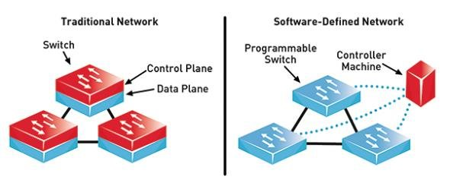
DIFFERNCE BETWEEN TN VS SDN

Slide 5
DIFFERENT BETWEEN TN AND SDN:
Software Defined Network is virtual networking approach.
Software Defined Network is centralized control.
This network is programmable.
It supports automatic configuration so it takes less time.
Traditional network is the old conventional networking approach.
Traditional Network is distributed control.
This network is non programmable.
It supports static/manual configuration so it takes more time.

Slide 6
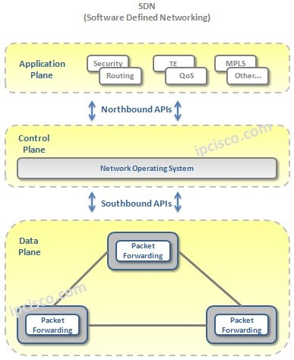
ARCHITECTURE OF SDN:

Slide 7
Different types of software-defined networking
Open SDN uses open protocols to control the virtual and physical devices responsible for routing the data packets.
API SDN uses programming interfaces, often called southbound APIs, to control the flow of data to and from each device.
Overlay Model SDN creates a virtual network above existing hardware, providing tunnels containing channels to data centers. This model then allocates bandwidth in each channel and assigns devices to each channel.’
Hybrid Model SDN combines SDN and traditional networking, allowing the optimal protocol to be assigned for each type of traffic. Hybrid SDN is often used as a phase-in approach to SDN.

Slide 8
Needs for sdn
Virtualization Use network resource
without worrying about where it is physically located
Dynamic Scaling Should be able to change size, quantity, capacity
Multi Tenancy Tenants need complete control over their • Addresses • Topology • Routing • Security

Slide 9
DATA PLANE:
Data Plane is consist of various Network devices both physical and Virtual. The main duty of data plane is Forwarding.
In the previous traditional networks, both control and data plane was in the same device. But with SDN, network devices has only data plane.

Slide 10
SDN CONTROLLER:
SDN Controller is the Center of the SDN Architecture and the most important one of SDN Architecture Components.
In other words, SDN Controller is the brain of the system. The control of all the data plane devices are done via SDN Controller. It also controls the Applications at Application Layer.

Slide 11
THANK YOU…

